Slide 2
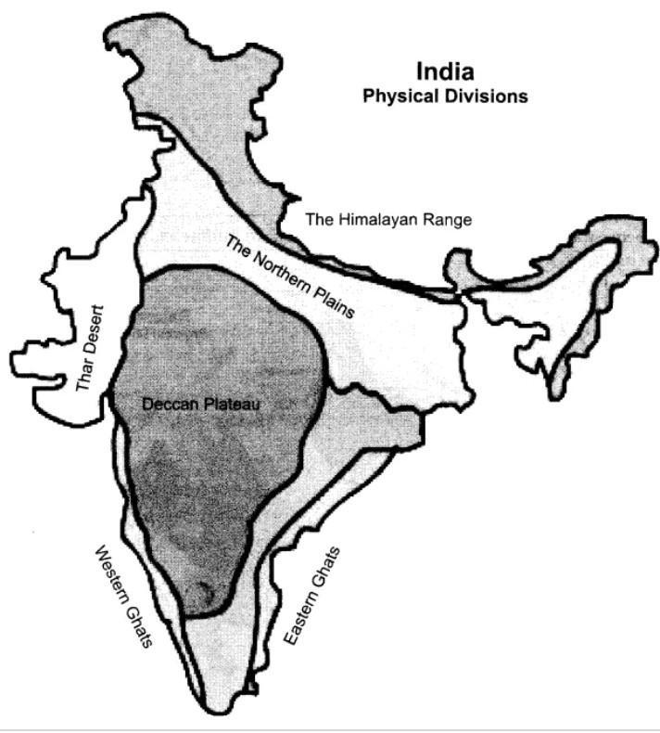
CONTENTS: 1.LOCATION 2.LAND 3.CLIMATE 4.NATURAL VEGETATION 5.WATER SUPPLY 6.OCCUPATIONS 7.HOUSES 8.LIFE STYLE 9.MAJOR CITIES
4.THE WESTERN DESERT

Slide 3
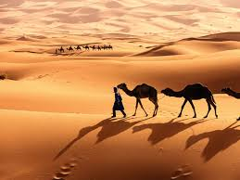
A PLACE WITH LITTLE OR NO RAIN. ROCKY AND SANDY
THE DESERT

Slide 4
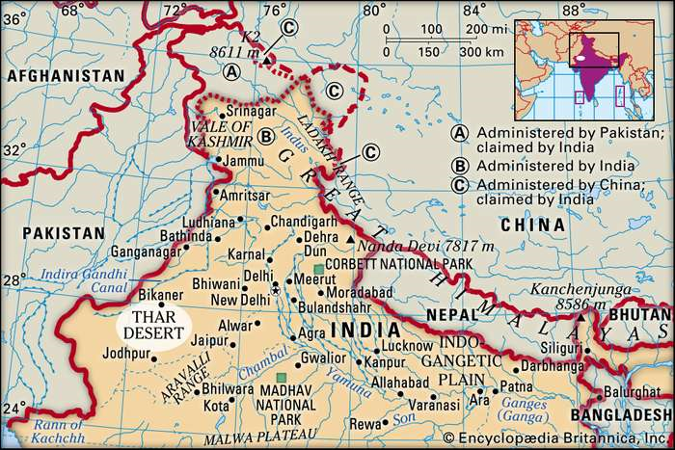
LOCATION
LIES TO THE WEST OF ARAVALLI HILLS.
ROCKY AND SANDY.
STRETCHES FROM THE RANN OF KACHCHH IN GUJARAT AND TO THE BORDERS OF HARYANA.

Slide 5
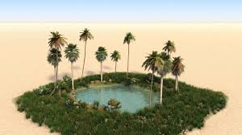
A SMALL HILLS OF SAND CALLED SAND DUNES . A LUSH GREEN AREA SURROUNDING A WATER SOURCE IN A DESERT IS CALLED AN OASIS.
LAND
Chapter 4/social/karunambigai/Sns Academy

Slide 6
REMAINS HOT AND DRY. IN SUMMER, DAYS ARE HOT AND NIGHTS ARE COOL. IN WINTER , DAYS ARE WARM AND NIGHTS ARE VERY COLD.
CLIMATE

Slide 7
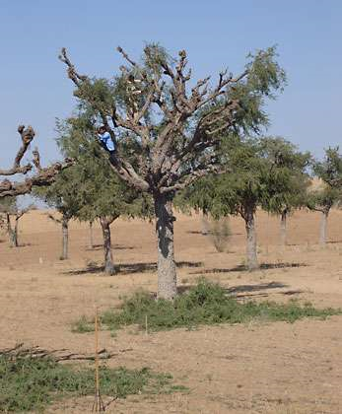
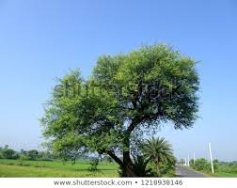
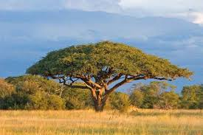
.
NATURAL VEGETATION.
KHEJRI
KIKAR
BABUL

Slide 8
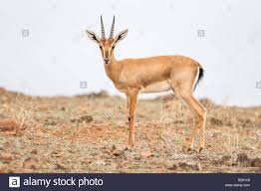
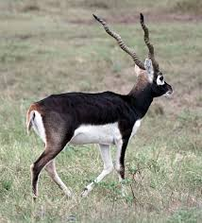
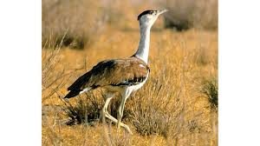
THE ANIMALS IN THE DESERT
GREAT INDIAN BUSTARD
CHINKARAS
BLACKBUCKS

Slide 9
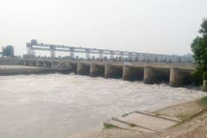
INDIRA GANDHI CANAL SUPPLY WATER. VILLAGE WOMEN WALK LONG DISTANCES TO FETCH WATER.
WATER SUPPLY

Slide 10
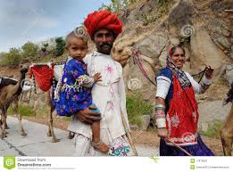
THEY ARE FARMERS. THEY GROW BAJRA,JOWAR,MAIZE,SESAME AND GROUNDNUT. PEOPLE TRAVEL FROM ONE PLACE TO ANOTHER IN SEARCH OF FOOD FOR THEMSELVES AND THEIR ANIMALS. THESE PEOPLE ARE CALLED BANJARAS.
OCCUPATION

Slide 11
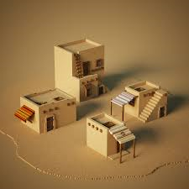
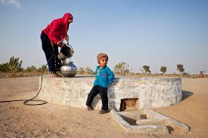
FLAT ROOF AND SMALL WINDOWS. THE WALLS ARE THICK TO KEEP THE HEAT OUT . HOUSES HAVE UNDERGROUND TANKS TO STORE RAINWATER ARE CALLED TAANKAS.
HOUSES

Slide 12
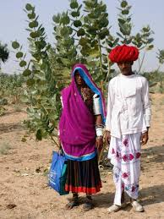
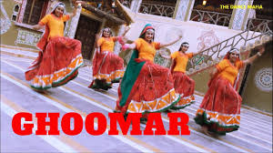
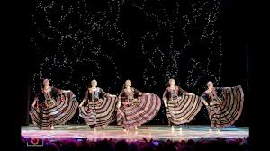
WOMEN IN VILLAGES WEAR GHAGHRA,CHOLI AND ODHNI. MEN WEAR DHOTI,KURTAAND TURBAN. GHOOMAR AND KALBELIYA ARE POPULAR DANCES
LIFESTYLE

Slide 13
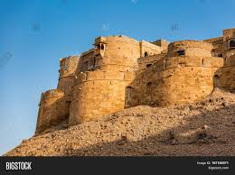
JAIPUR,UDAIPUR,JODHPUR,JAISALMER AND BIKANER. JAIPUR IS CALLED AS PINKCITY.FAMOUS FOR BLUE POTTERY.
MAJOR CITIES
JAISALMER FORT

